Slide 1

Domain: Android
Technology: Kotlin
Agri Tourism

Slide 2
Block Diagram
Search Places
View Crop info and farmer info
Add Booking
History
Register
User
Add Farmers
View Farmers
View user
Data base
Login
Admin
Farmer
Add Crops
View crops
View request
Update status

Slide 3
Class Diagram

Slide 4

UML diagrams use case

Slide 5
UML diagrams Sequence

Slide 6
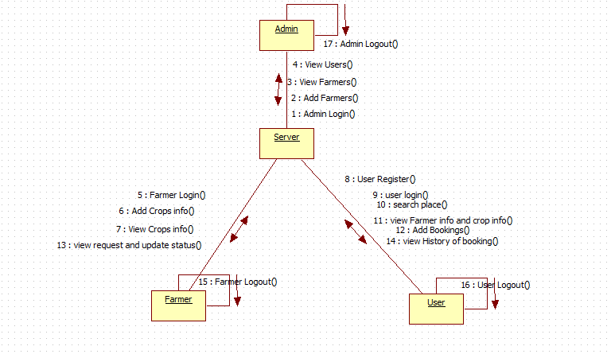
UML diagrams Collaboration

Slide 7
UML diagrams activity

Slide 8
UML diagrams Component

Slide 9
UML diagrams Deployment

Slide 10
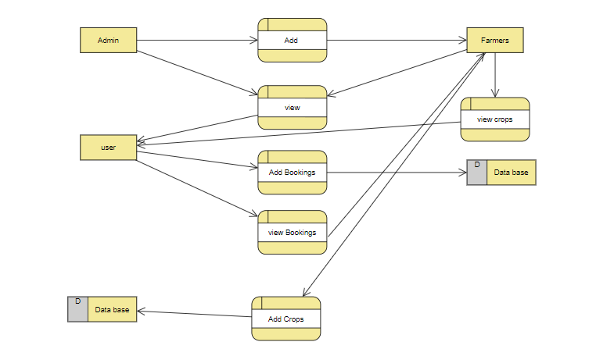
DFD diagrams

Slide 11
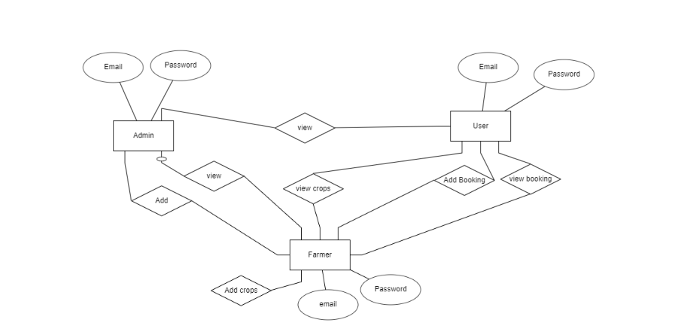
ER diagrams

